Slide 1
HokieTickets
Workflows for the VT Blockchain Challenge 2020
The Goblins
Sameer Dandekar, Nathan Kennedy, Ankita Khera, Rachel Kitchen, Niles Rogoff

Slide 2
Table of Contents
Buy tickets
Enter the lottery
Sell tickets
Auction tickets
View your auctions
Method 1
Method 2
Enter auctions
Scan tickets

Slide 3
Buy Tickets
Table of Contents

Slide 4
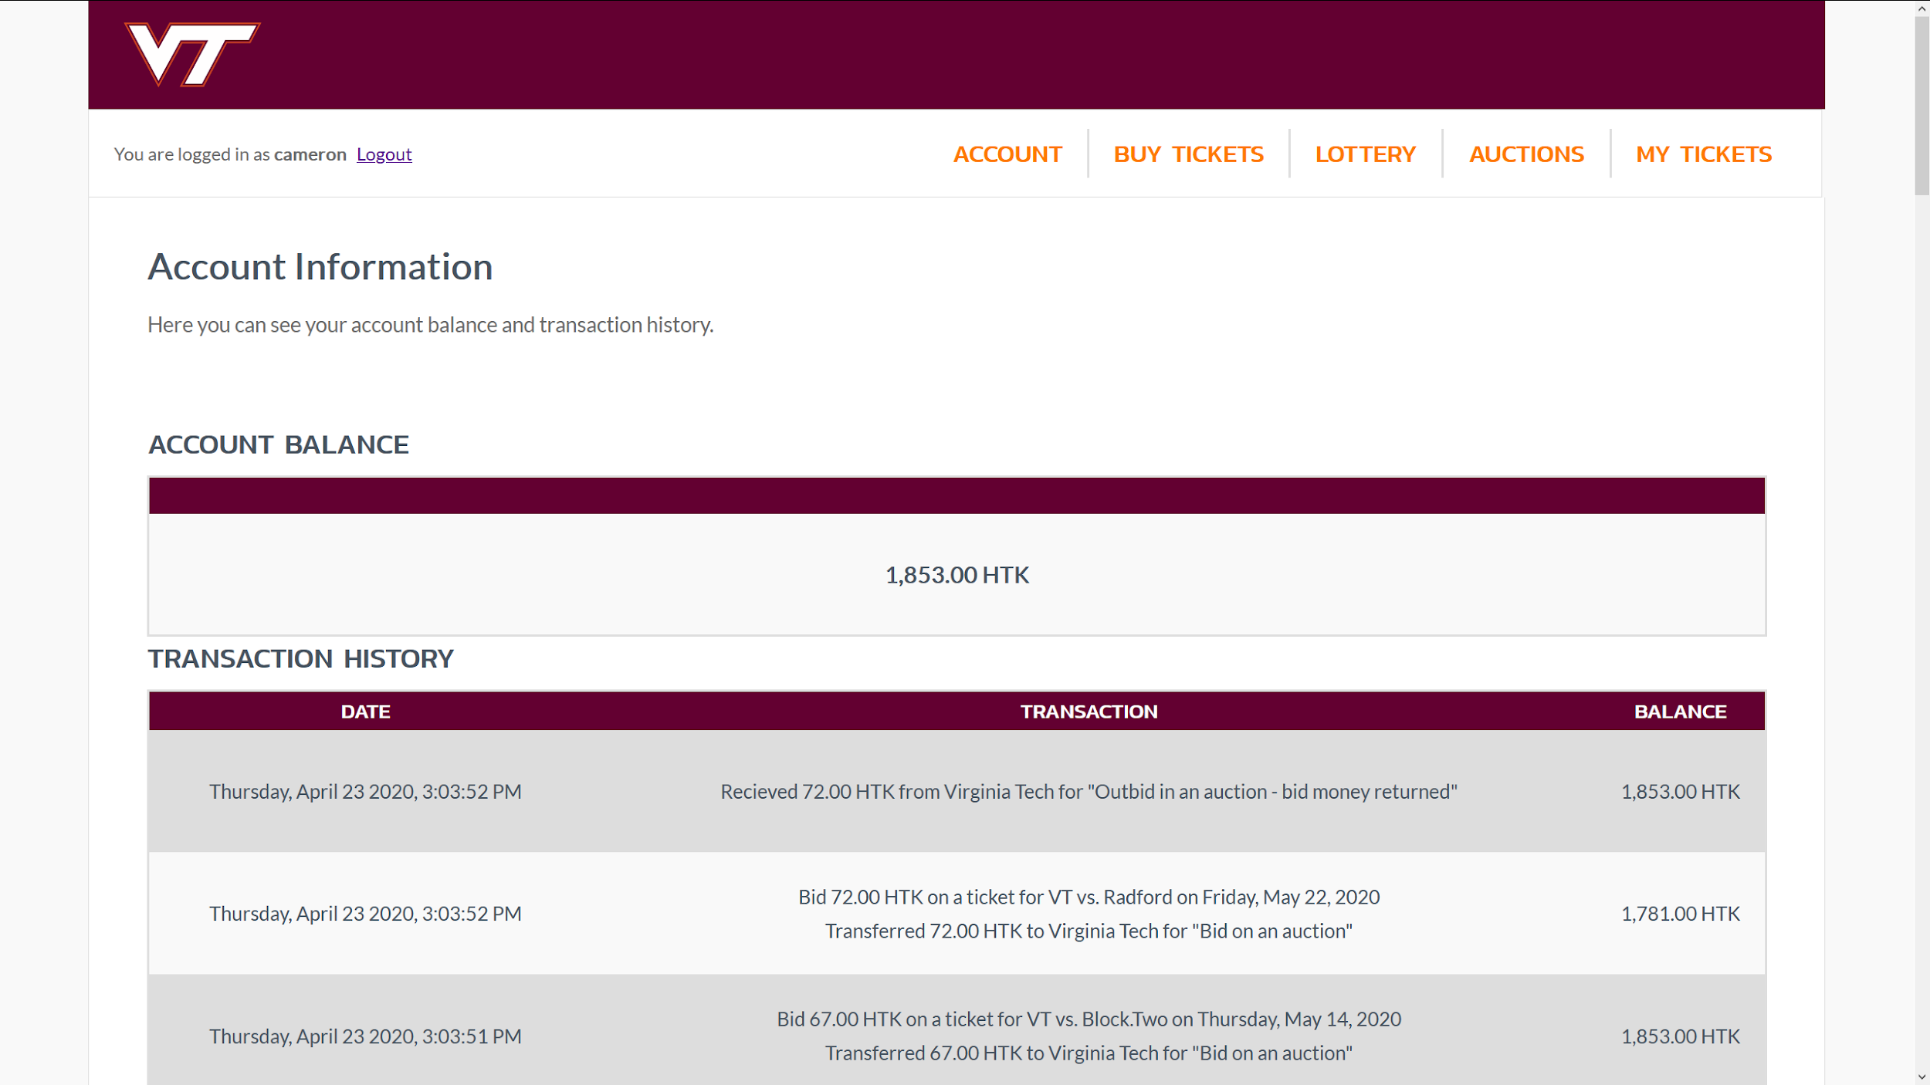
Navigate to the “Buy Tickets” page

Slide 5
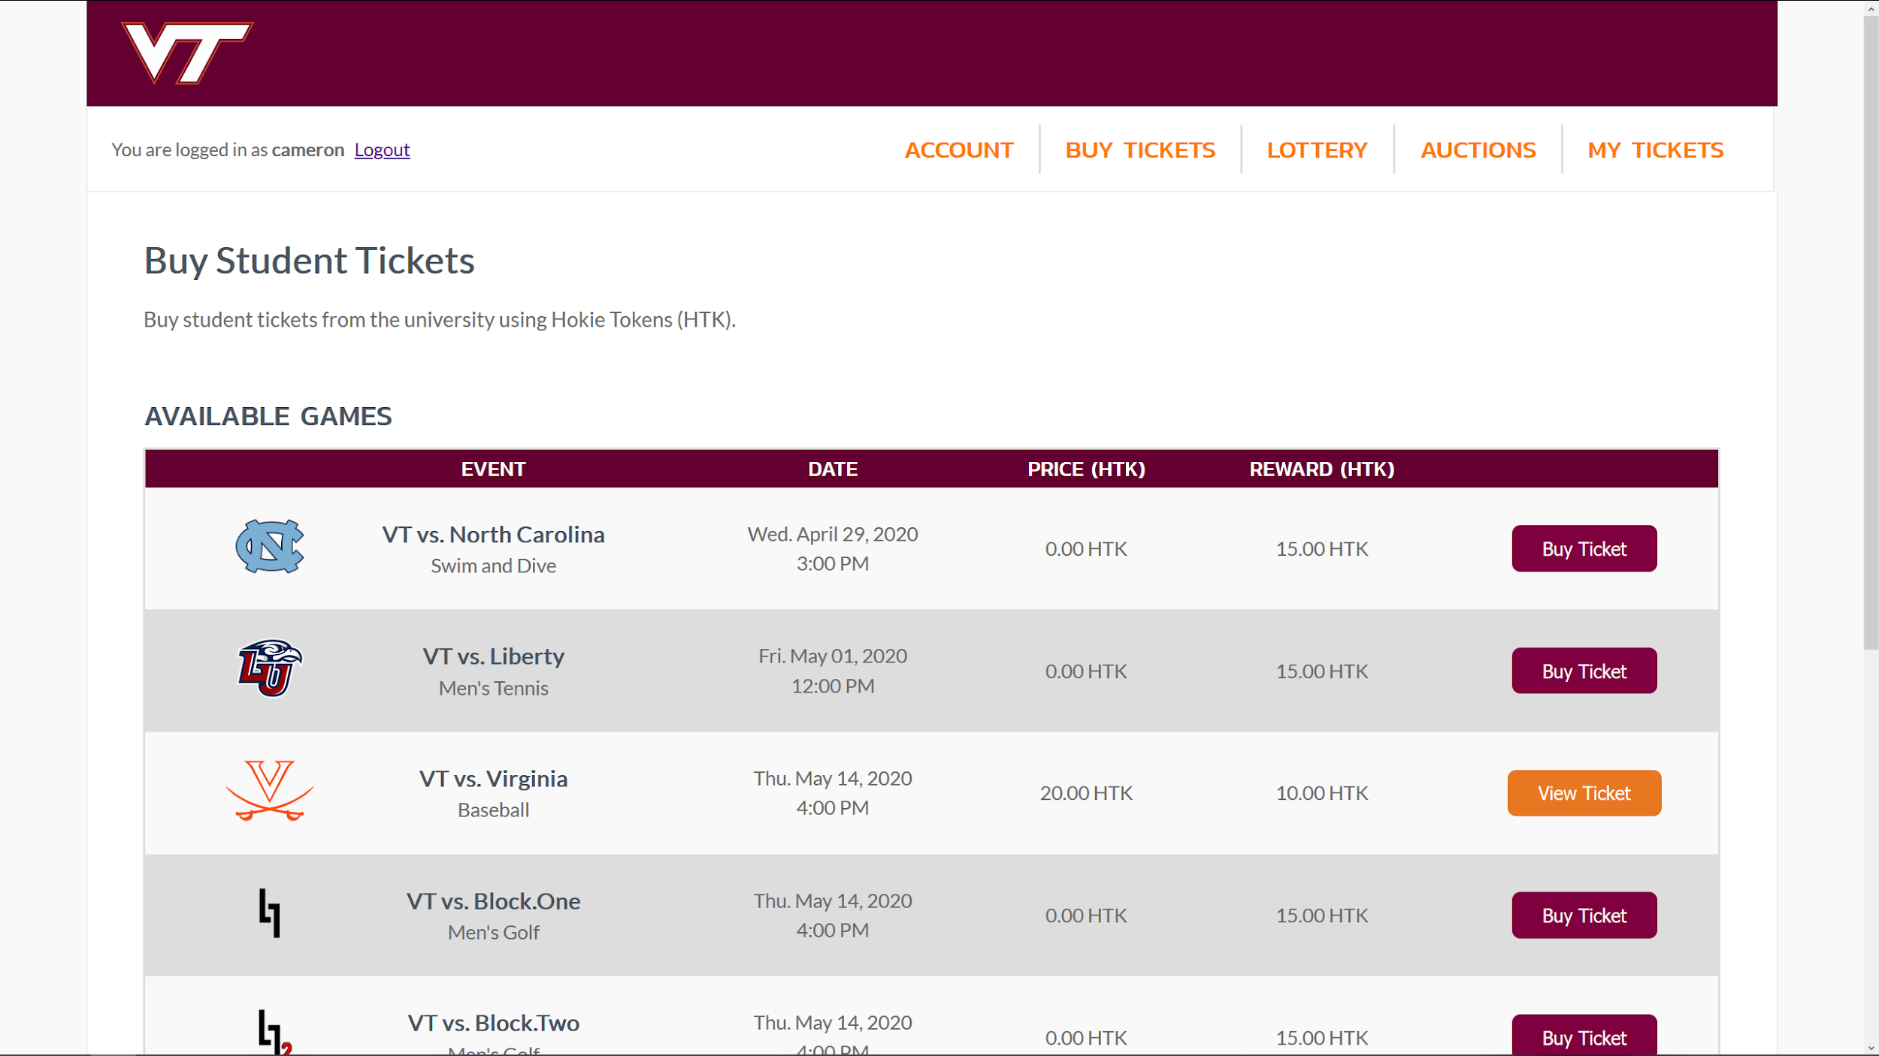
Select “Buy Ticket” from one of the games on the list

Slide 6
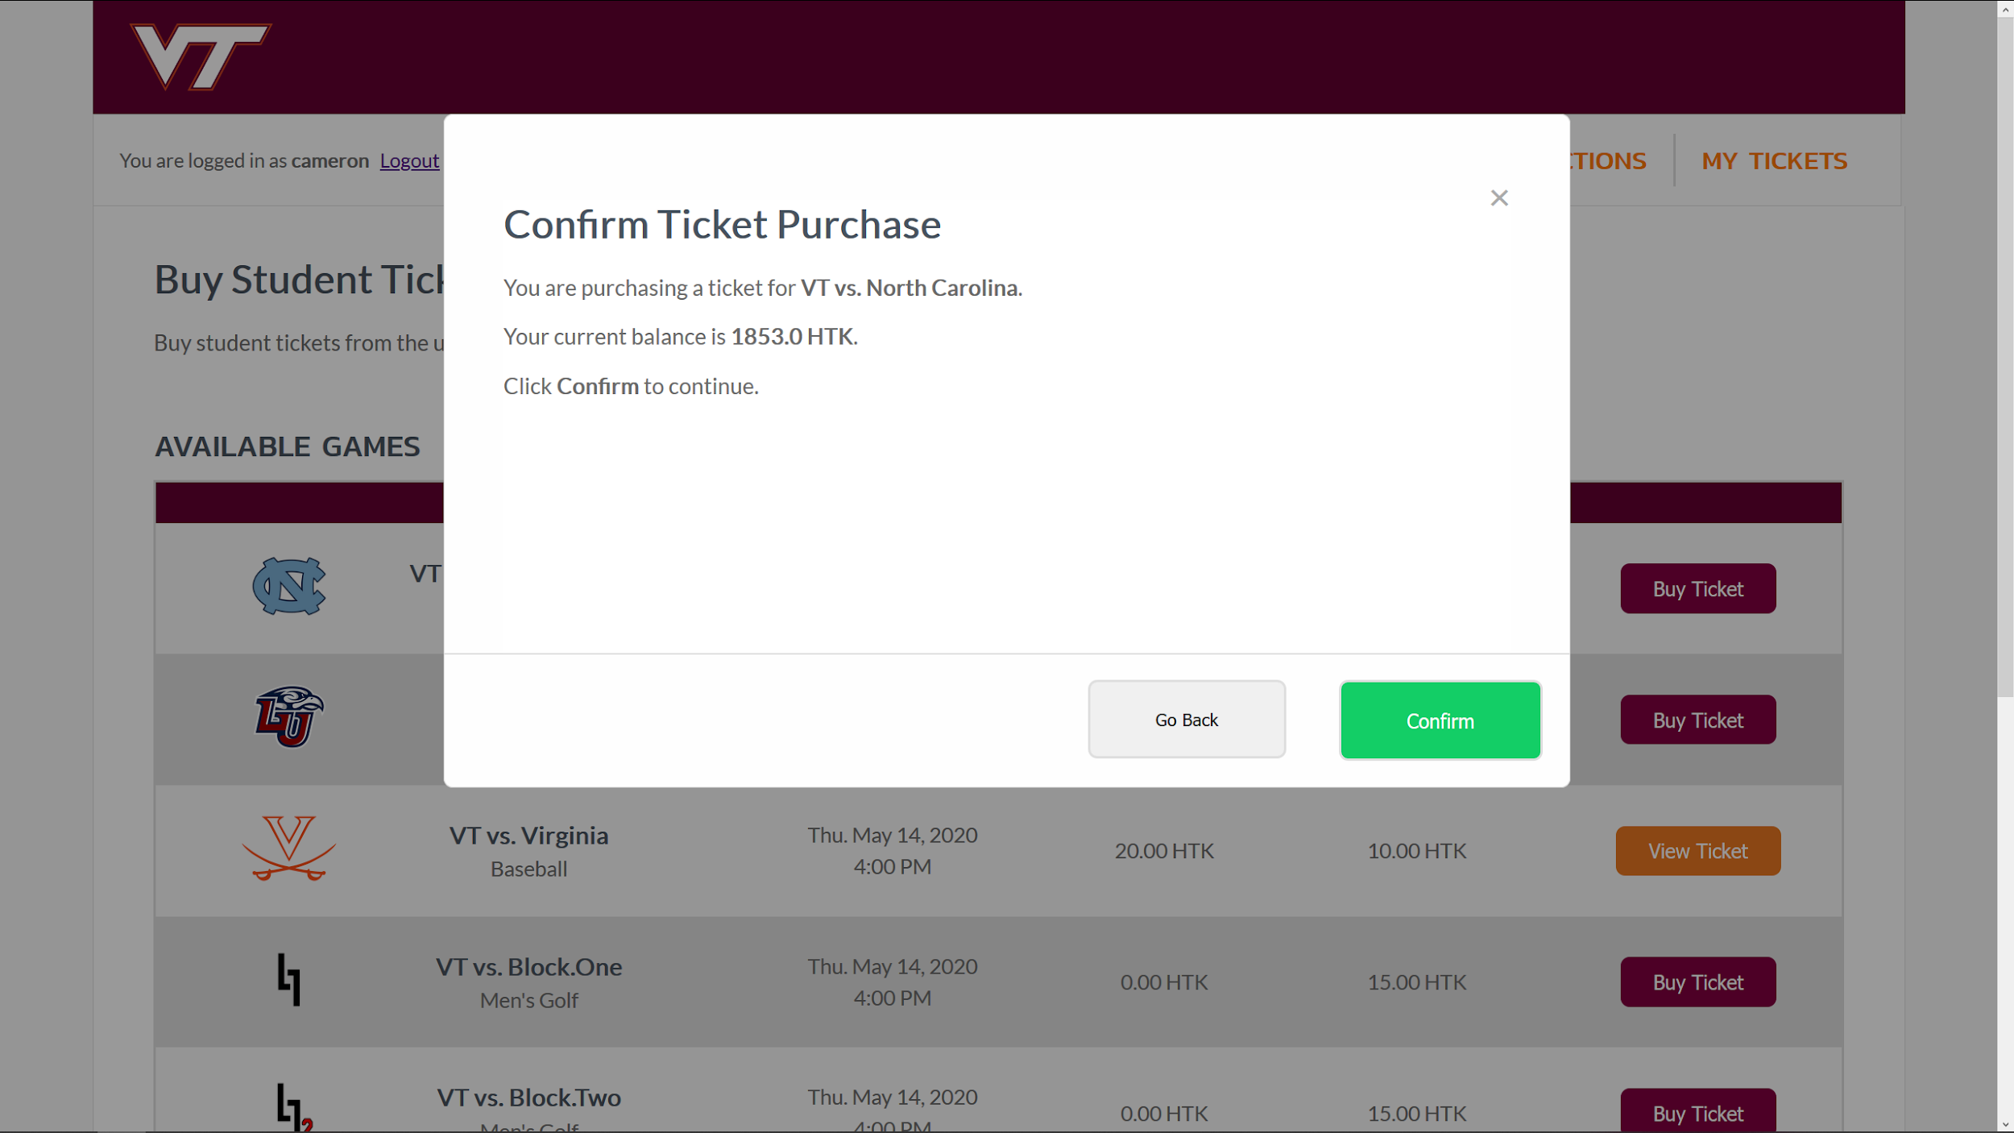
Confirm your purchase in the pop-up window

Slide 7
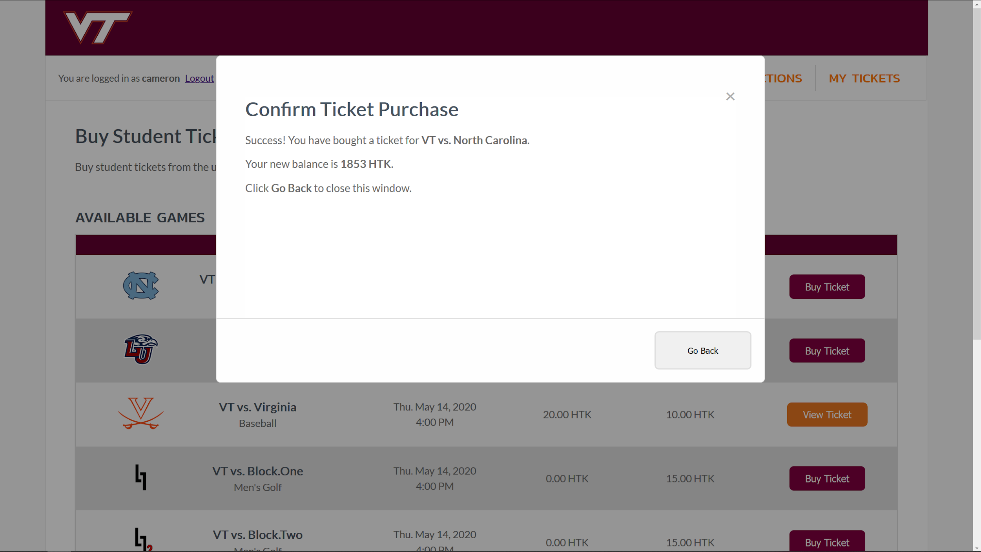
Success! The ticket has been bought.

Slide 8
Enter the lottery
Table of Contents

Slide 9
Navigate to the “Lottery” page

Slide 10
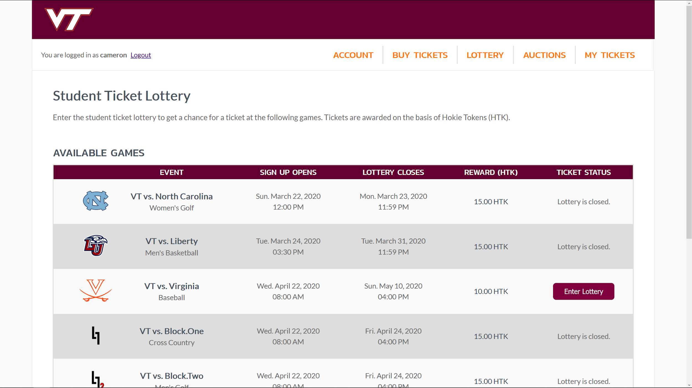
Press the “Enter Lottery” button for an available game

Slide 11
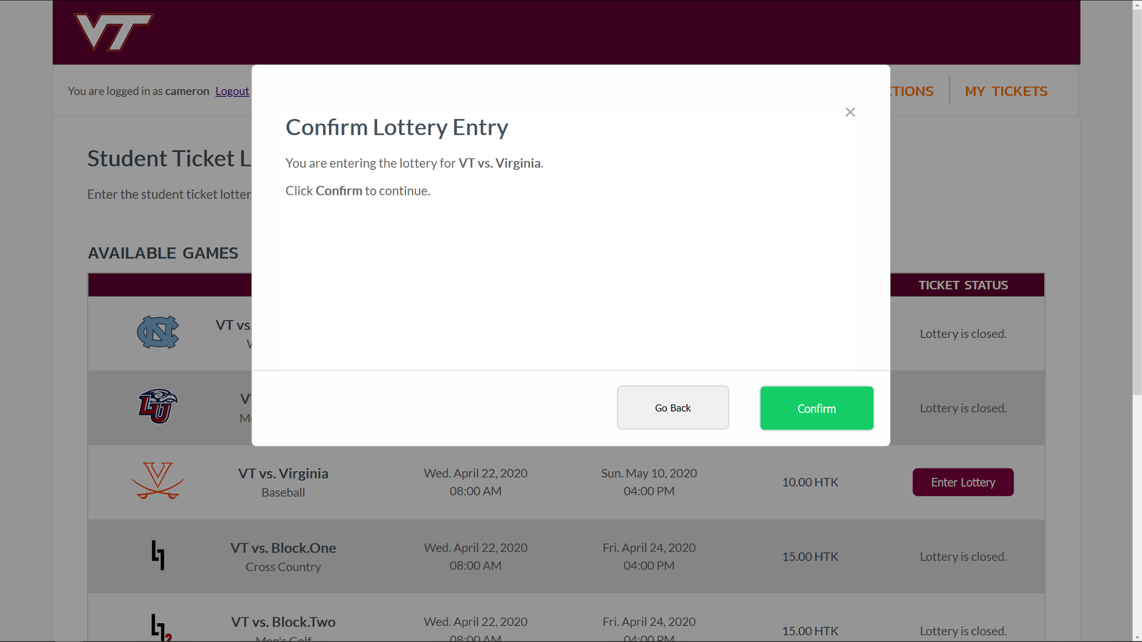
Confirm entering the lottery in the pop-up window

Slide 12
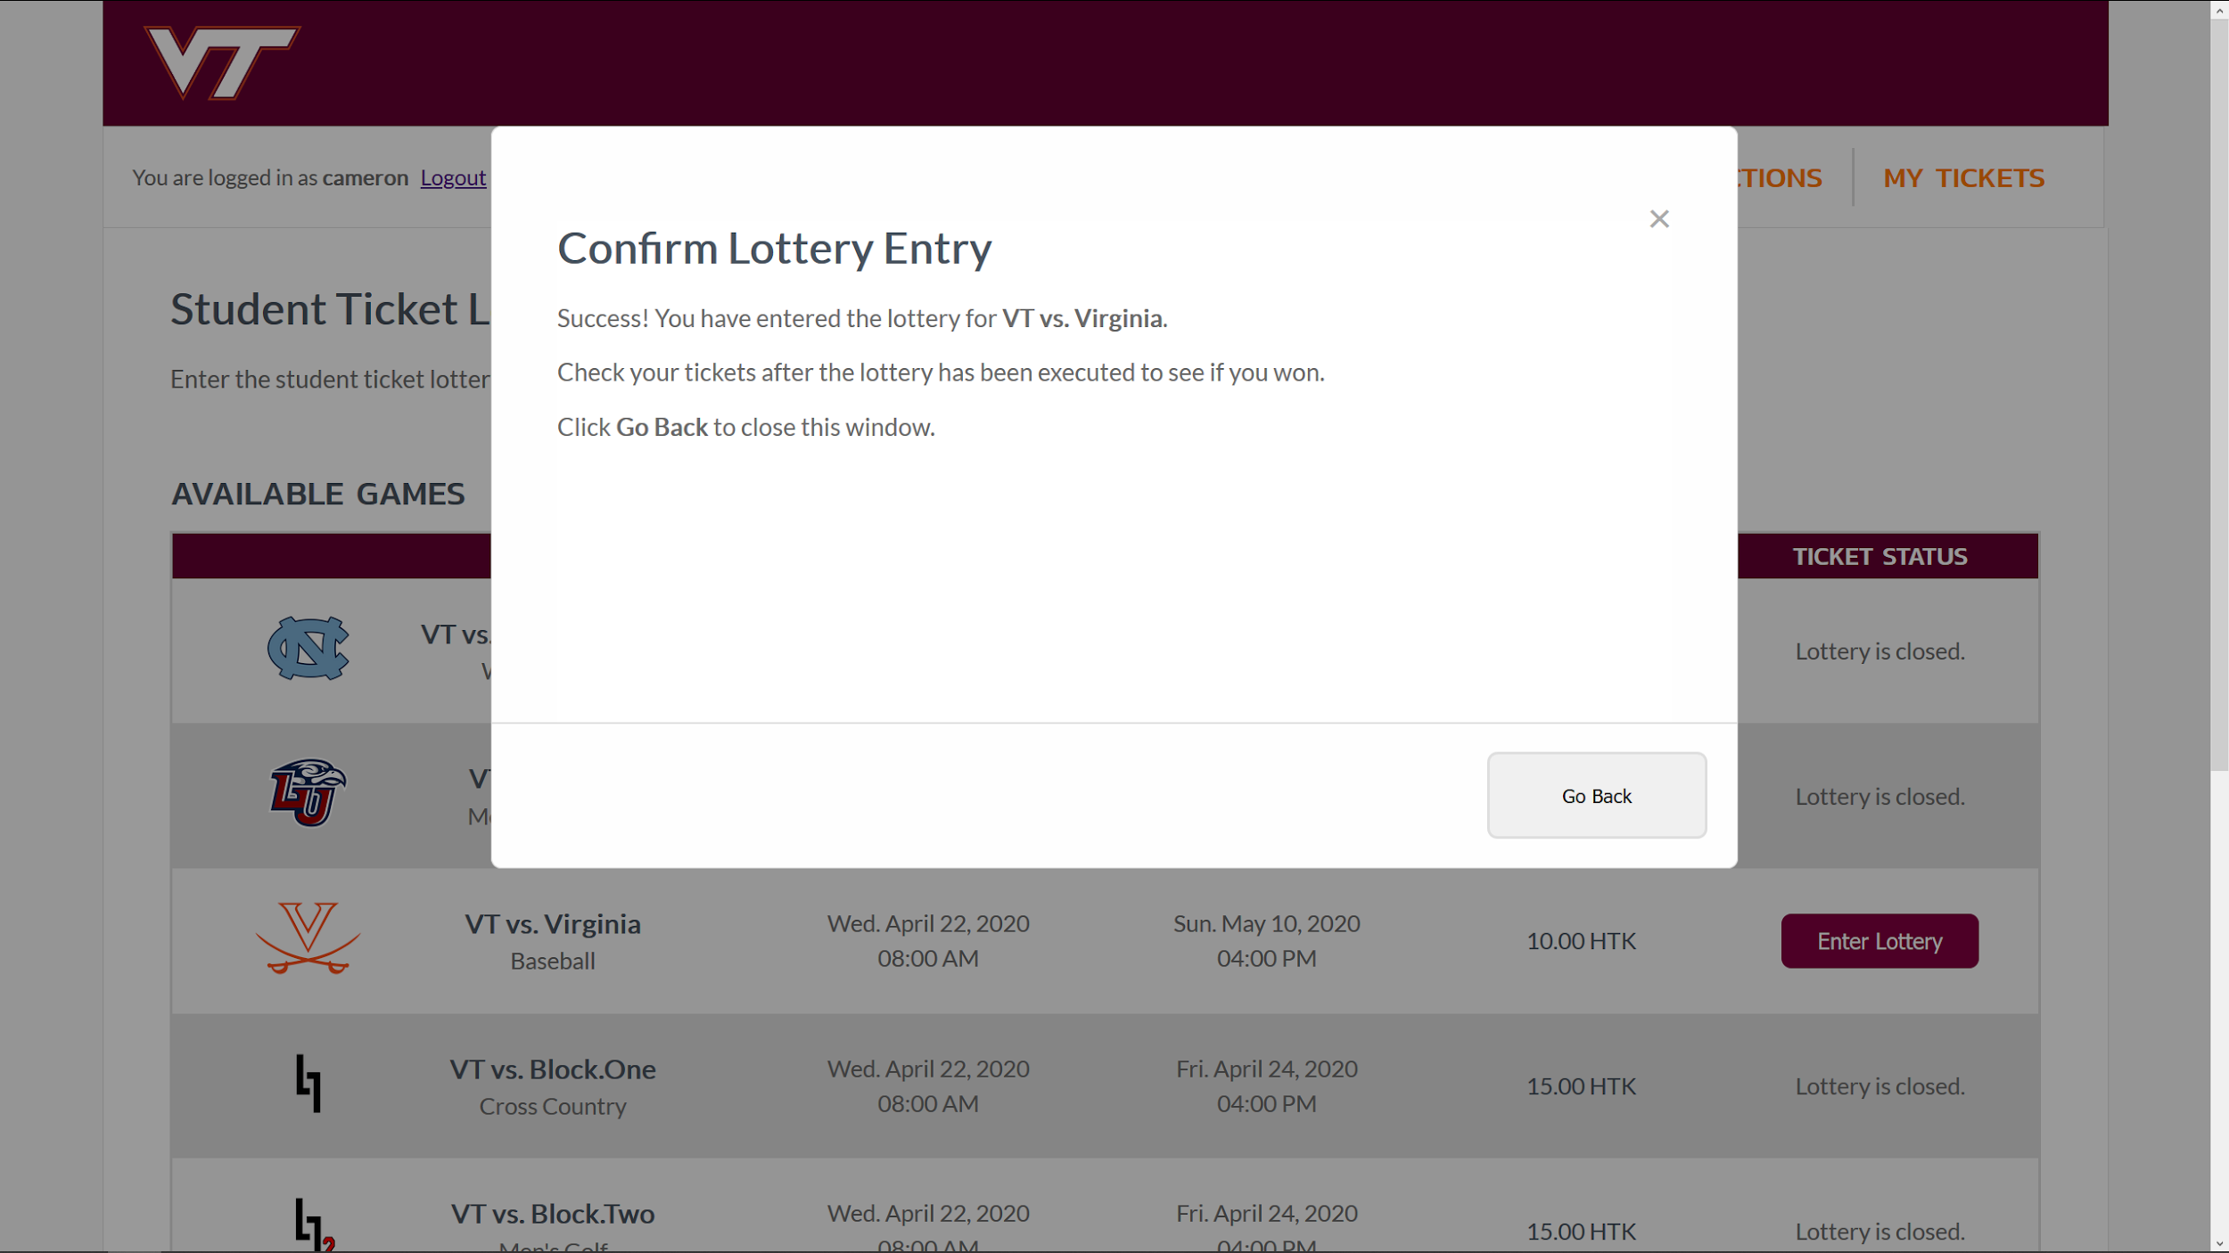
Success! You are now in the lottery for this game.

Slide 13
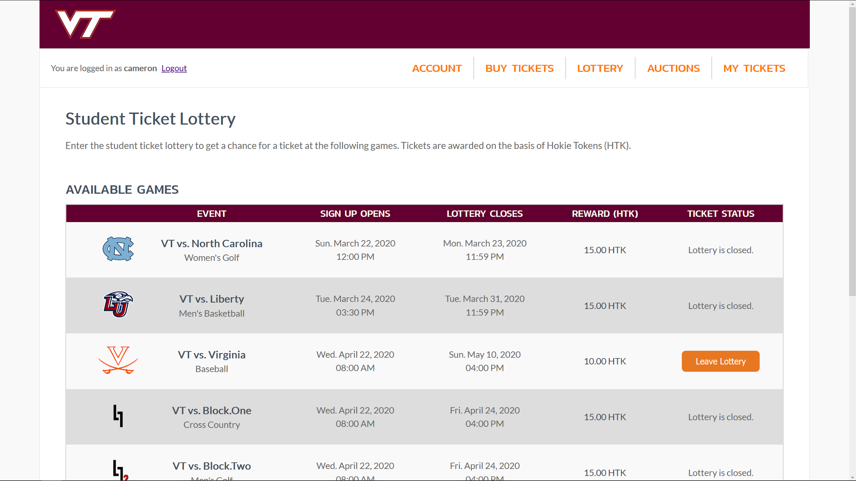
The “Enter Lottery” button has updated to a “Leave Lottery” button

Slide 14
Sell tickets
Table of Contents

Slide 15
Navigate to the “My Tickets” page

Slide 16
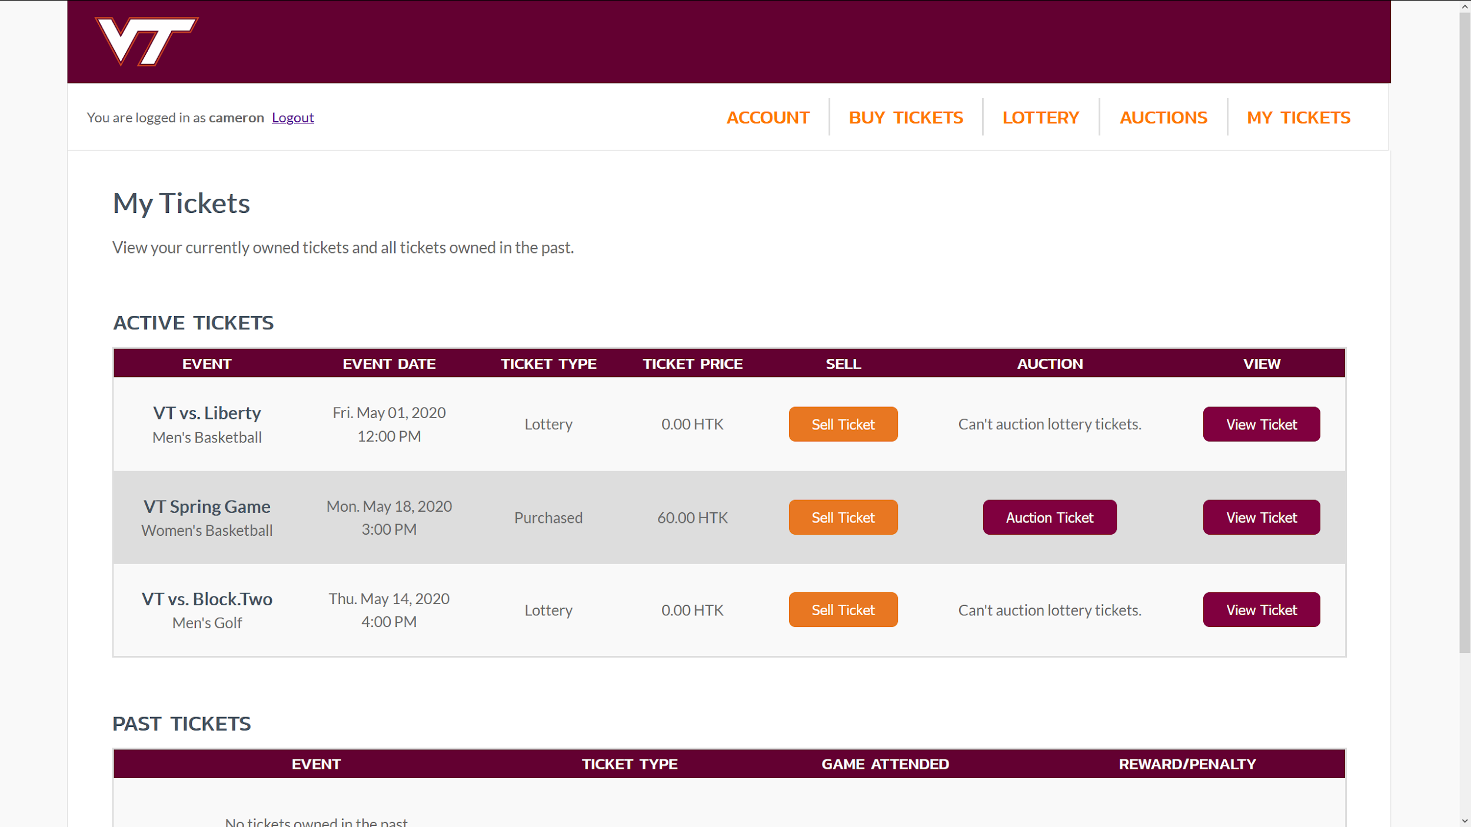
Press the “Sell Ticket” button for an available ticket

Slide 17
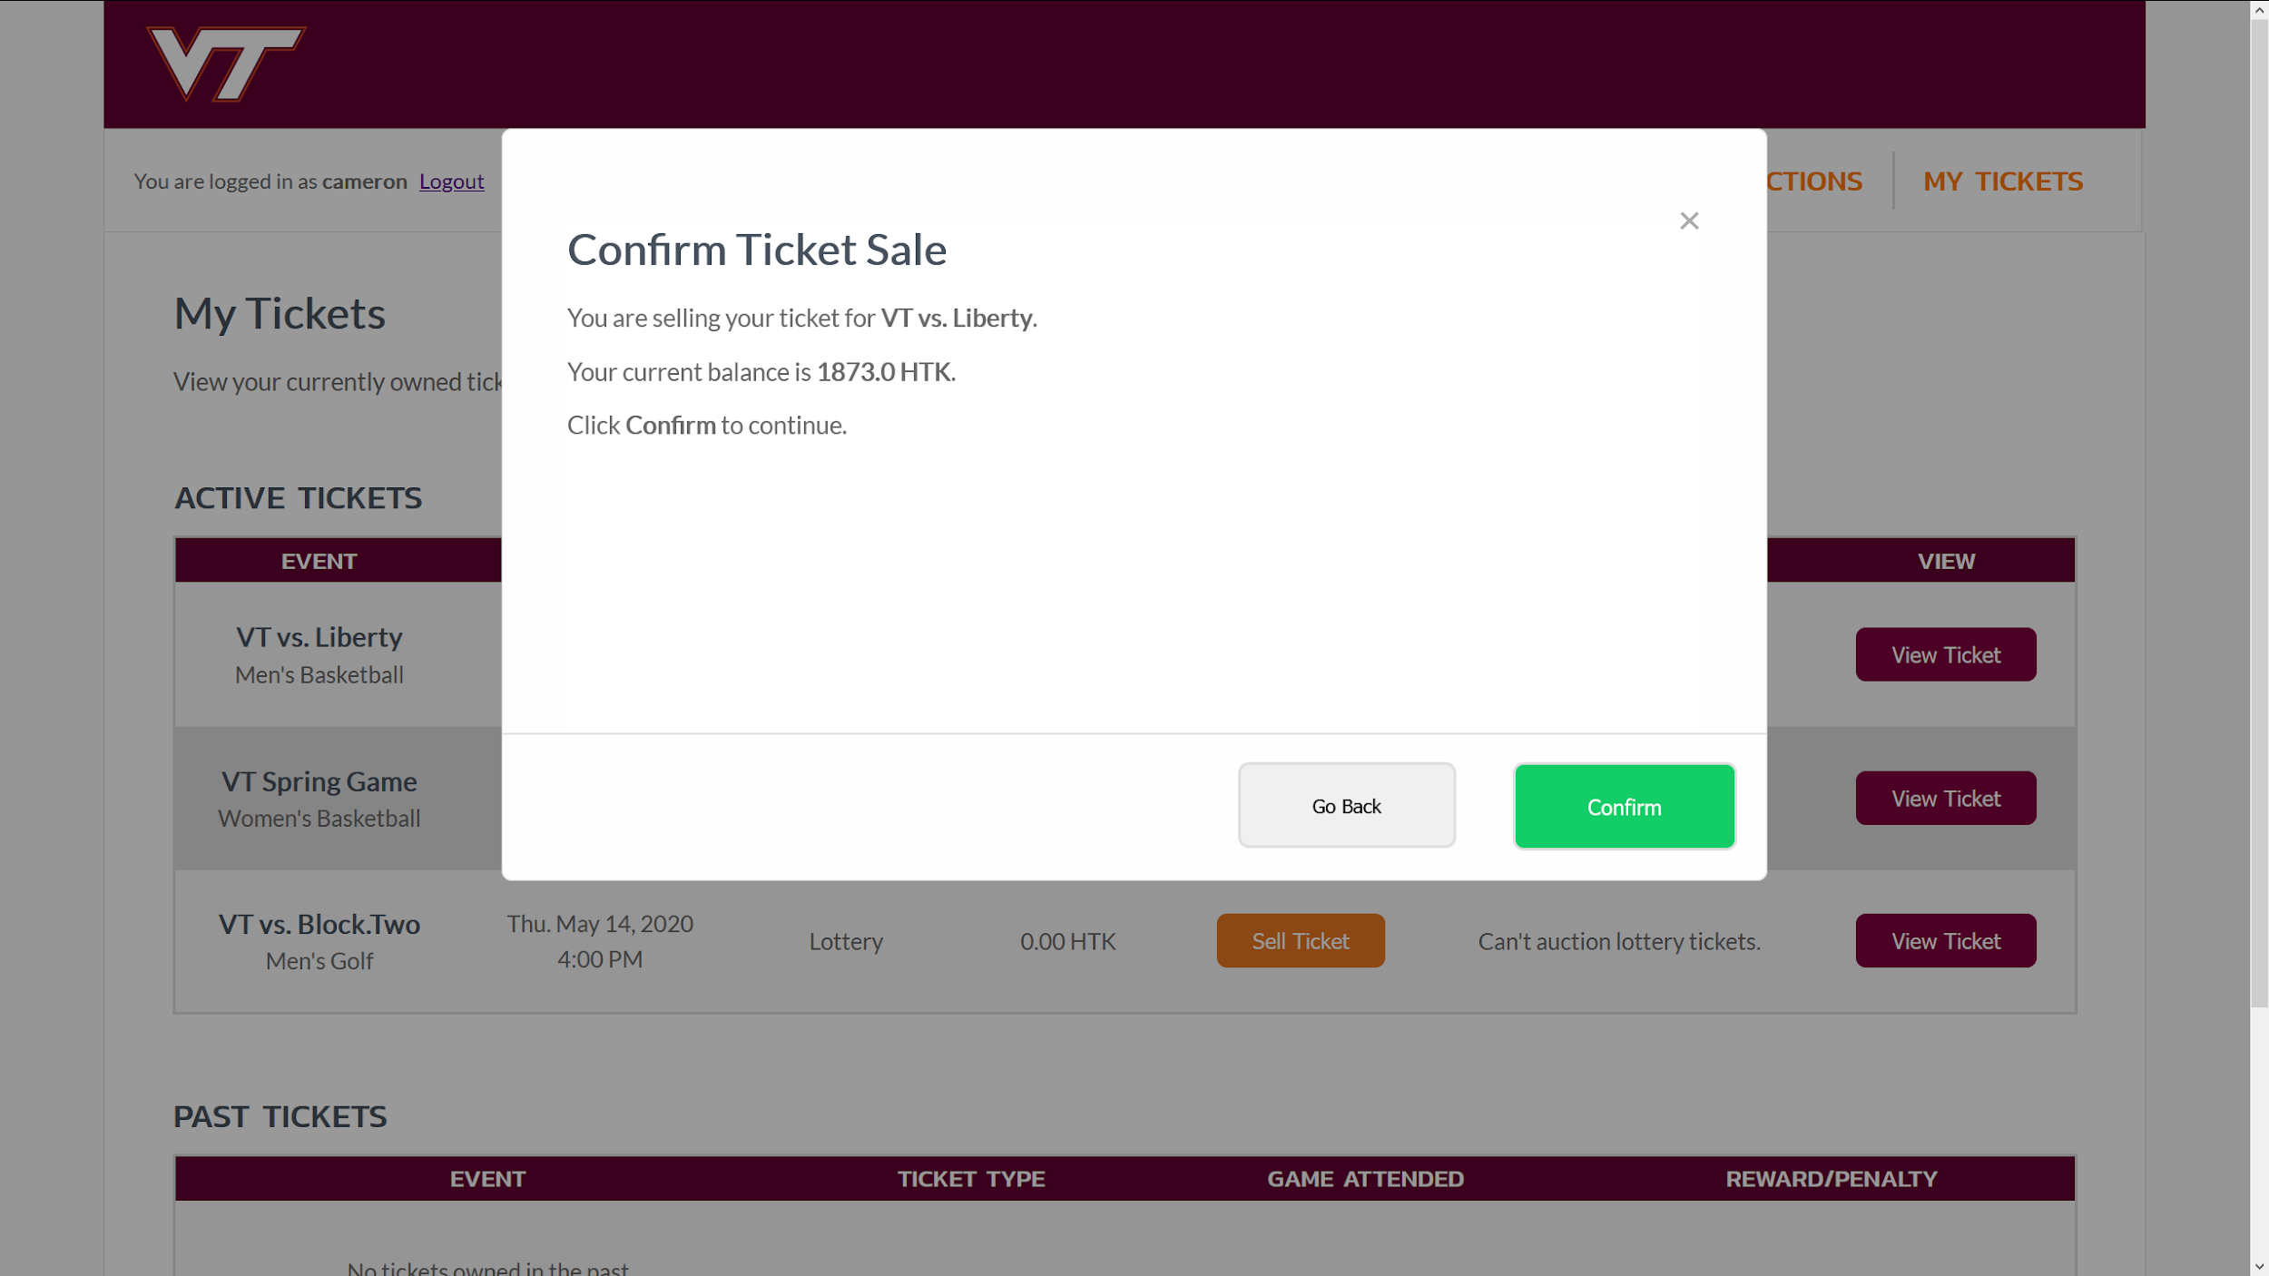
Confirm selling the ticket in the pop-up window

Slide 18
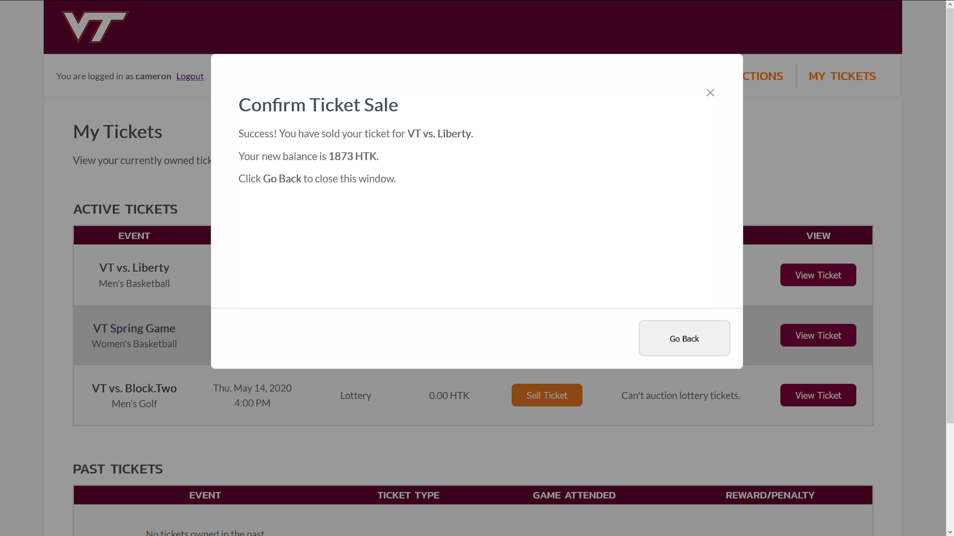
Success! You have sold the ticket.

Slide 19
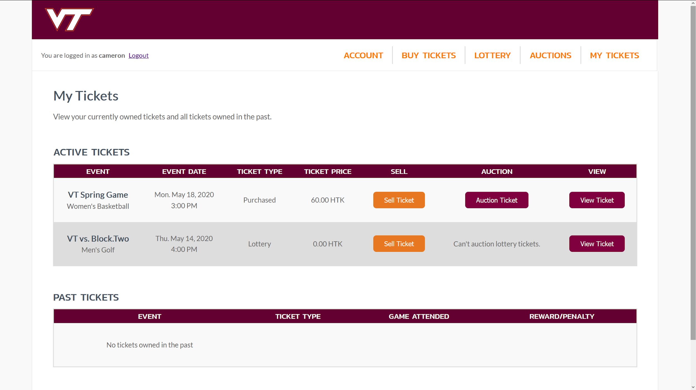
The ticket no longer shows up in the “My Tickets” page

Slide 20
Auction tickets
Table of Contents

Slide 21
Navigate to the “My Tickets” page

Slide 22
Press the “Auction Ticket” button for an available ticket

Slide 23
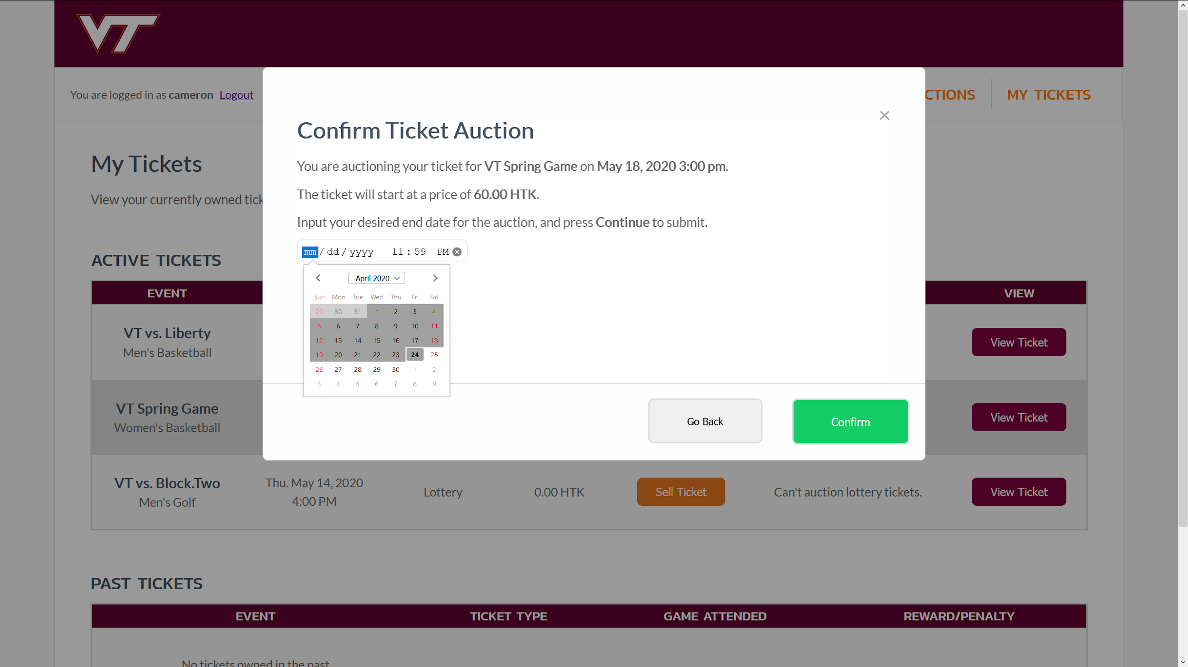
In the pop-up window, enter a date and time for the auction to end, then click “Confirm”

Slide 24

Success! Your ticket is up for auction.

Slide 25
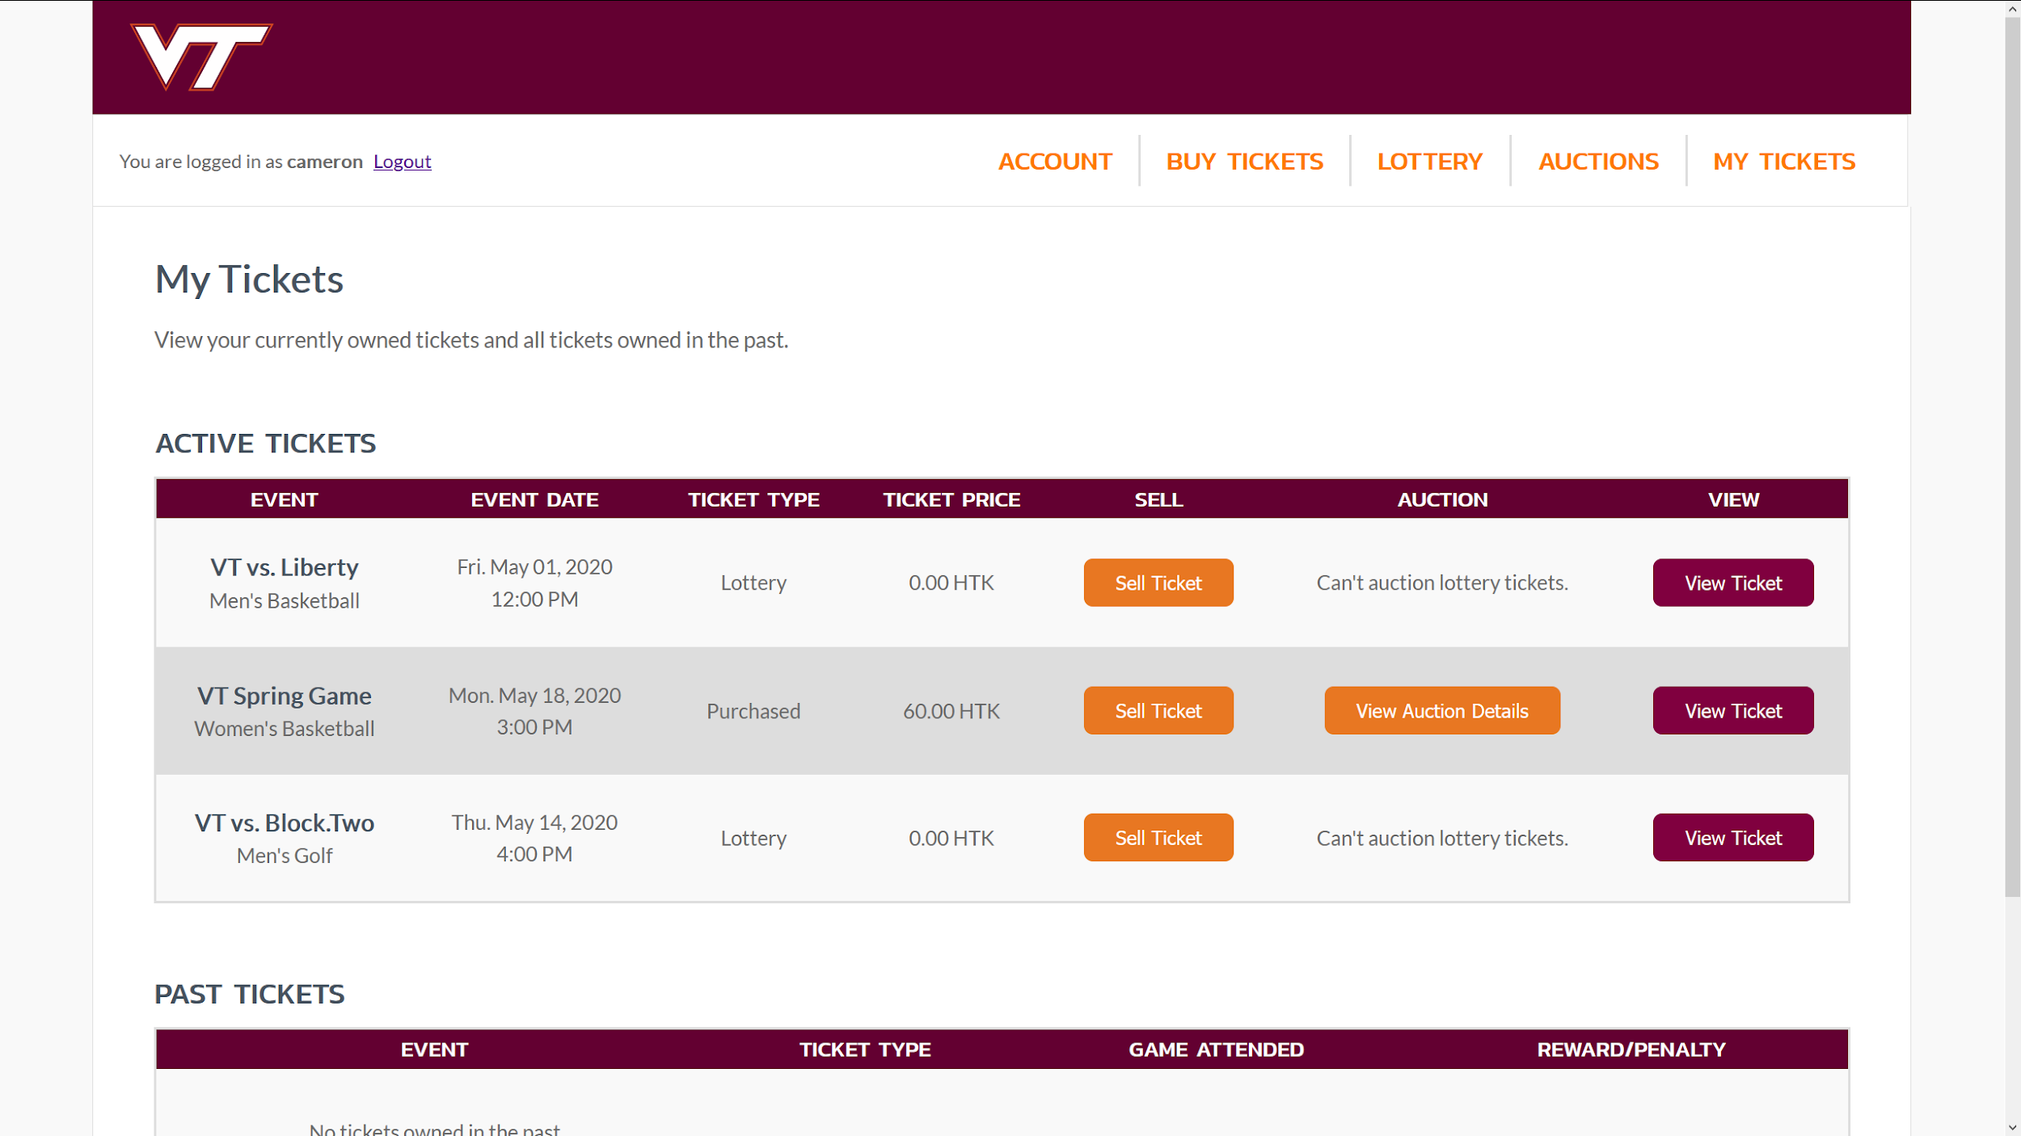
“Auction Ticket” has been updated to “View Auction Details”

Slide 26
View your auctions - Method 1
Table of Contents

Slide 27

Navigate to the “My Tickets” page

Slide 28
Select “View Auction Details”

Slide 29
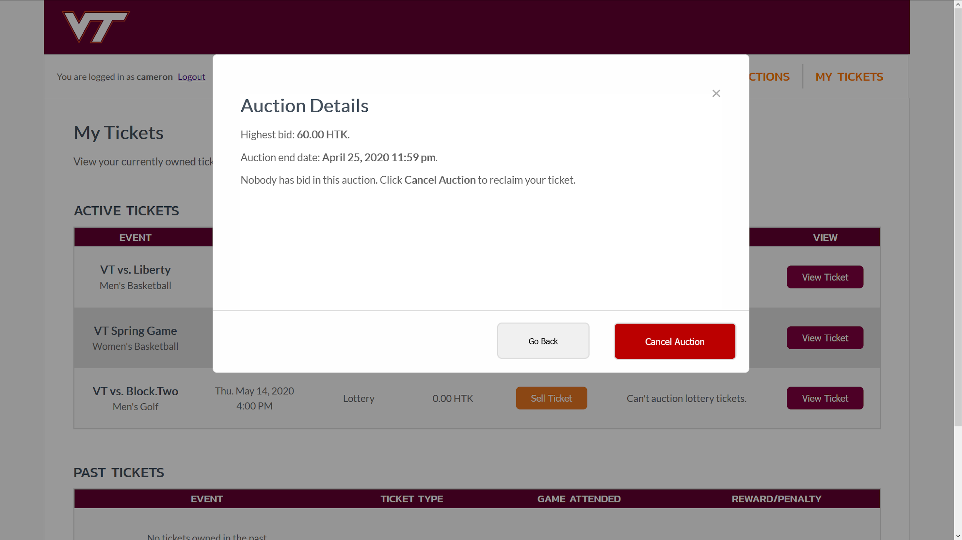
Pop-up window shows highest bid and auction end date

Slide 30
View your auctions - Method 2
Table of Contents

Slide 31
Navigate to the “Auctions” page

Slide 32
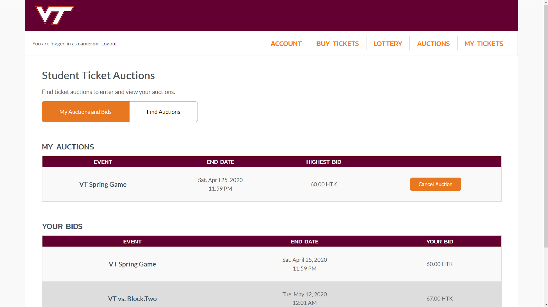
Your owned auctions with end date and highest bid are shown

Slide 33
Enter auctions
Table of Contents

Slide 34
Navigate to the “Auctions” page

Slide 35
Select the “Find Auctions” tab

Slide 36
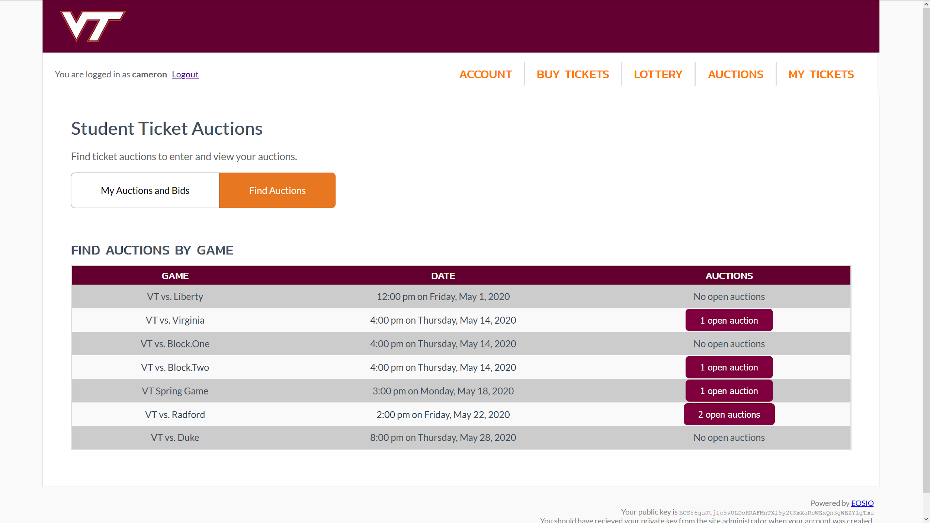
Choose to look at the available auctions for one of the games in the list

Slide 37
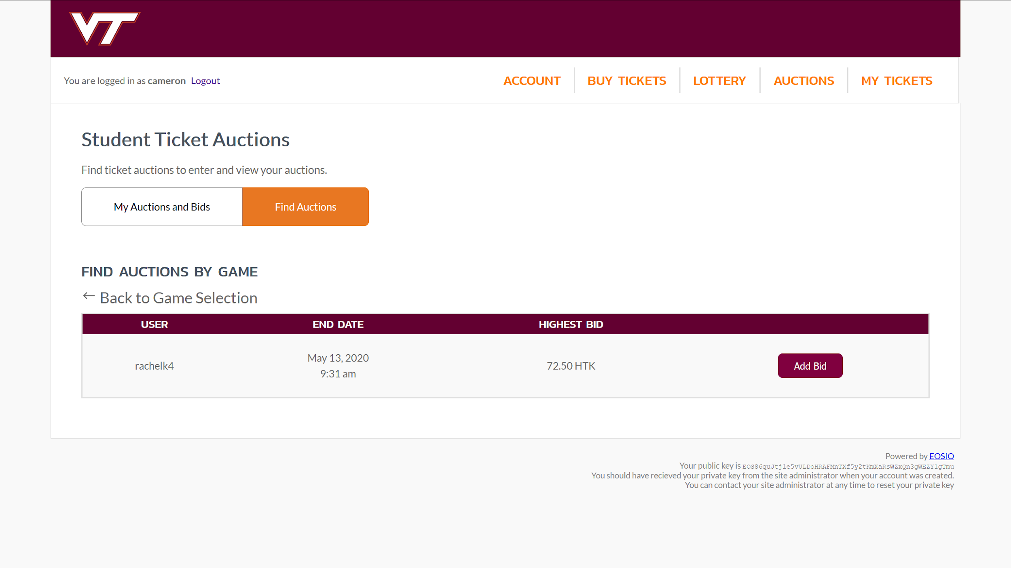
Select “Add Bid”

Slide 38
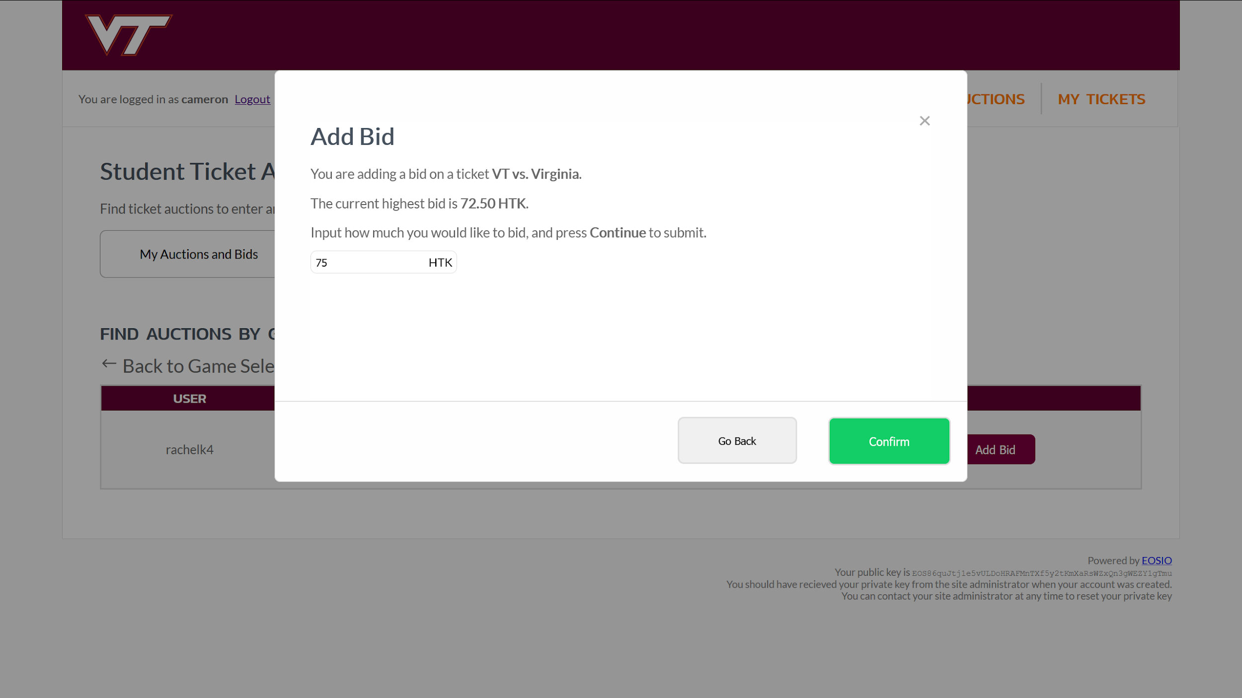
Enter the amount of HokieTokens to bid, then click “Confirm”

Slide 39
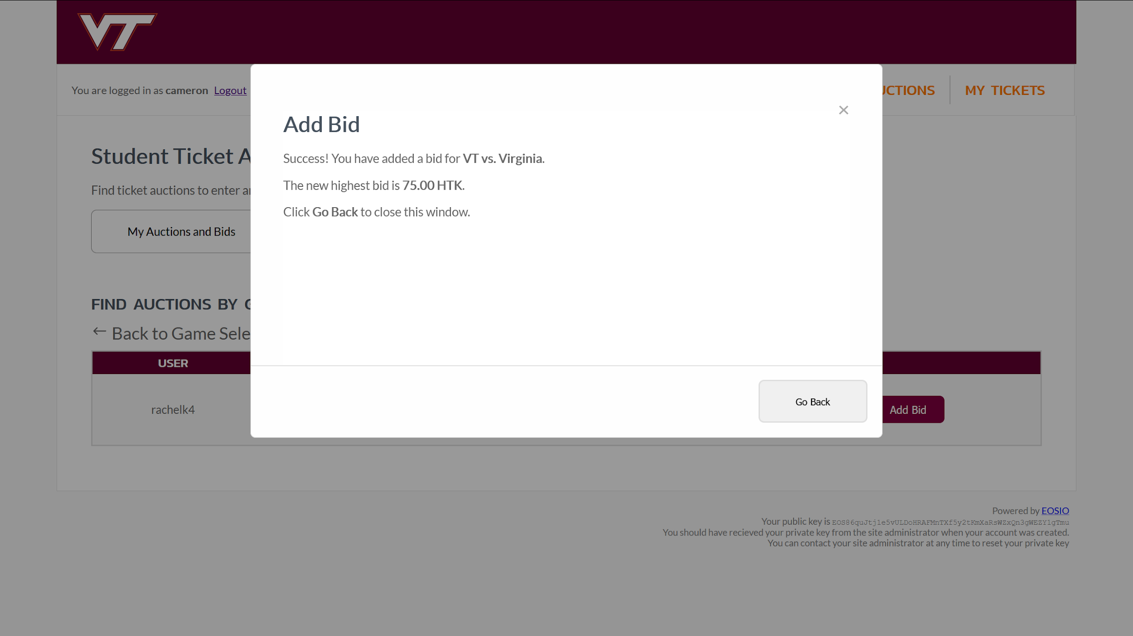
Success! Your ticket is up for auction.

Slide 40
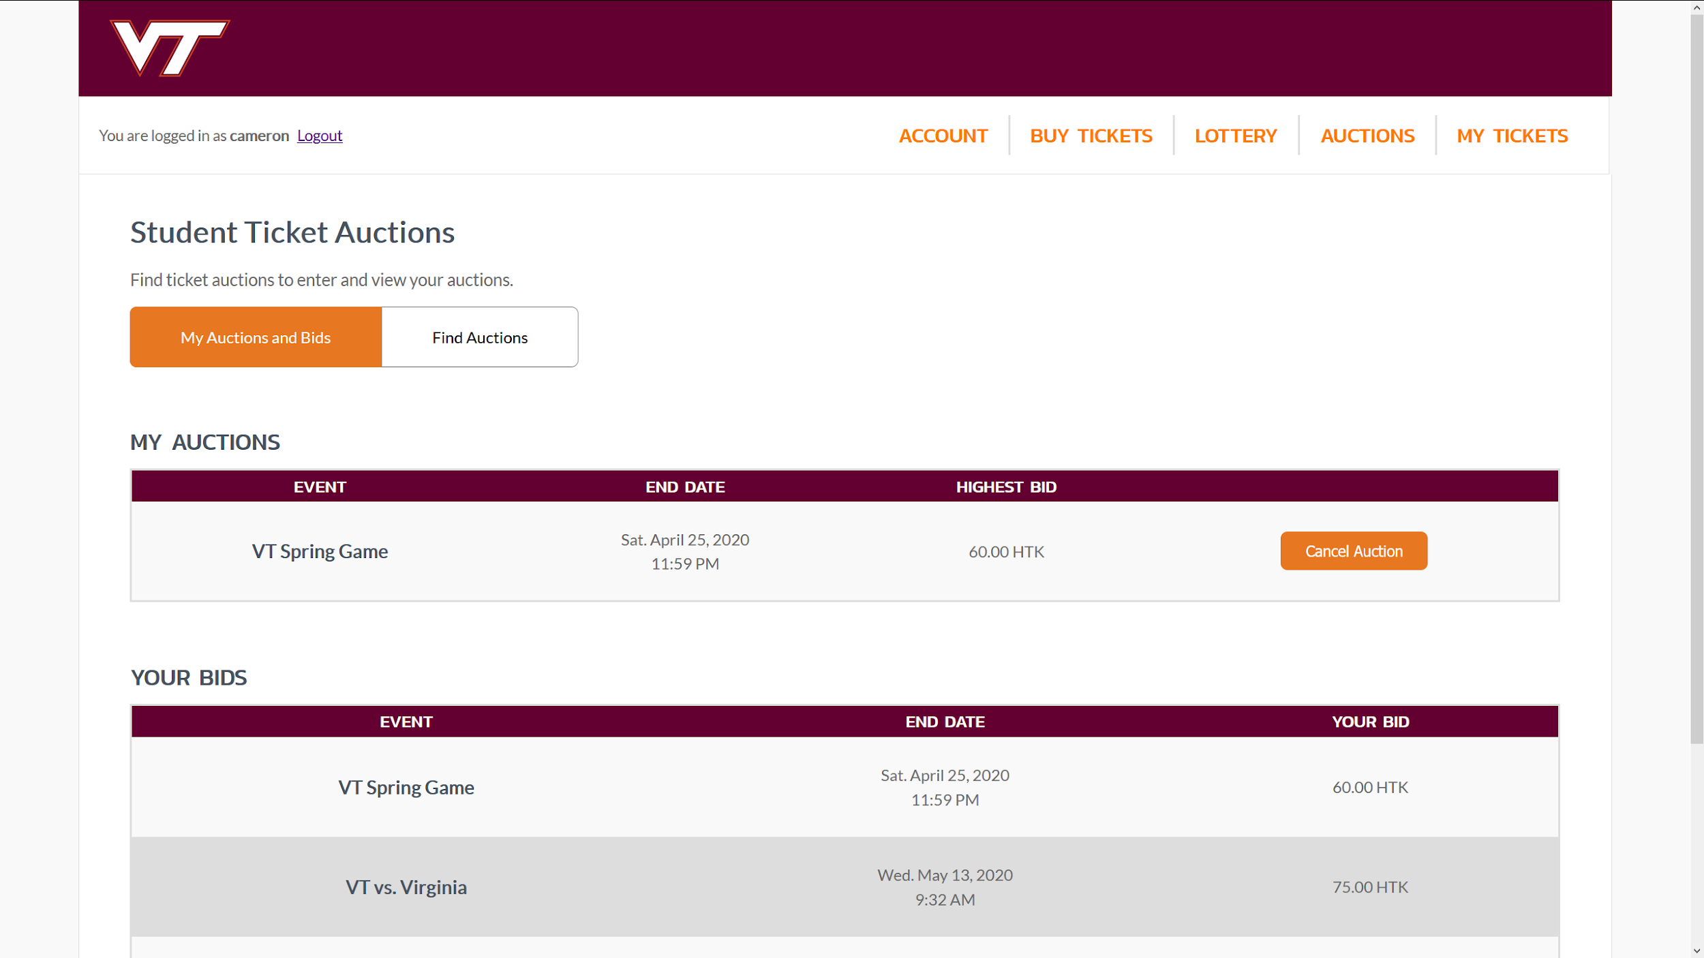
The auction now shows up in the “Your Bids” section

Slide 41
Scanning tickets
Table of Contents

Slide 42
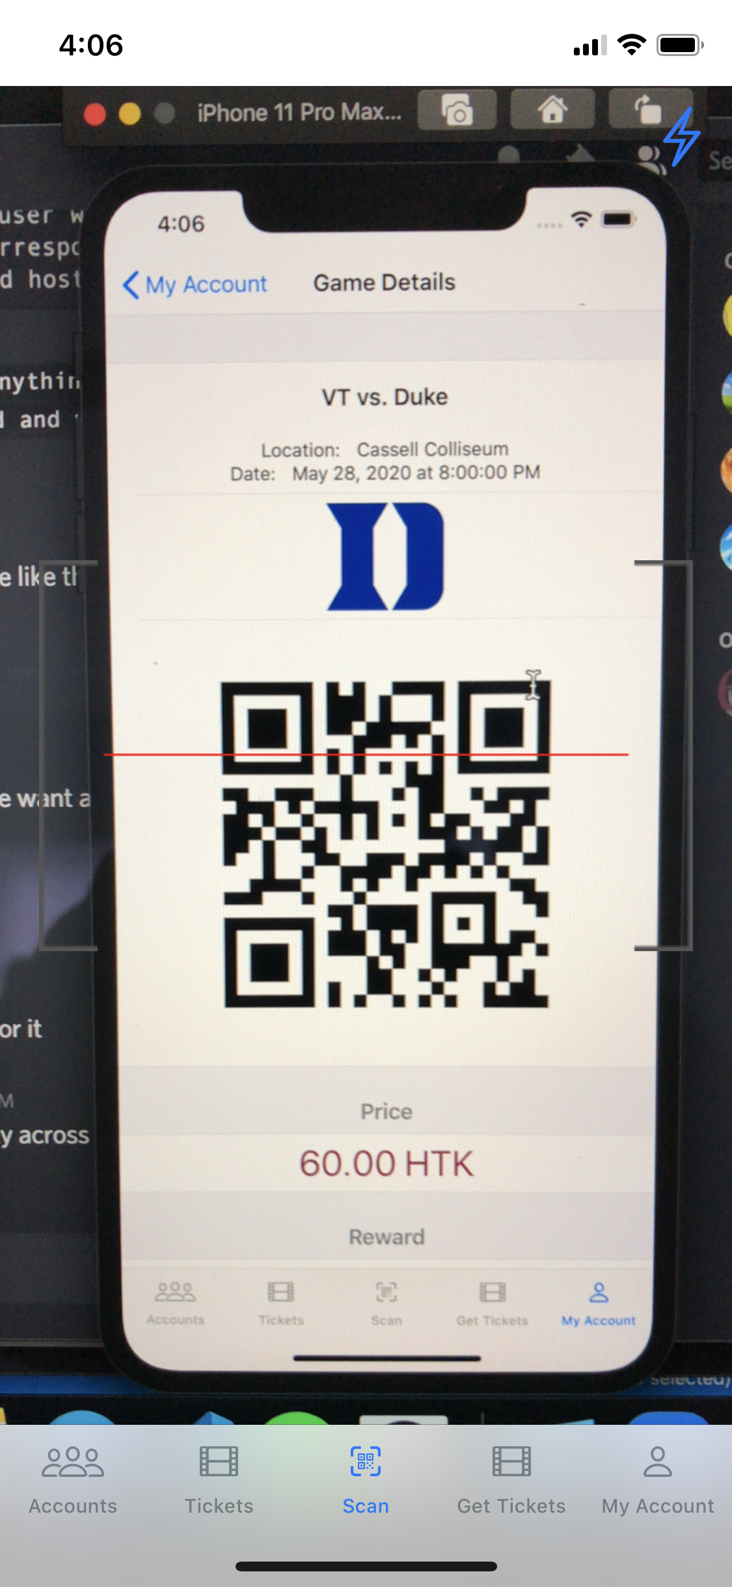
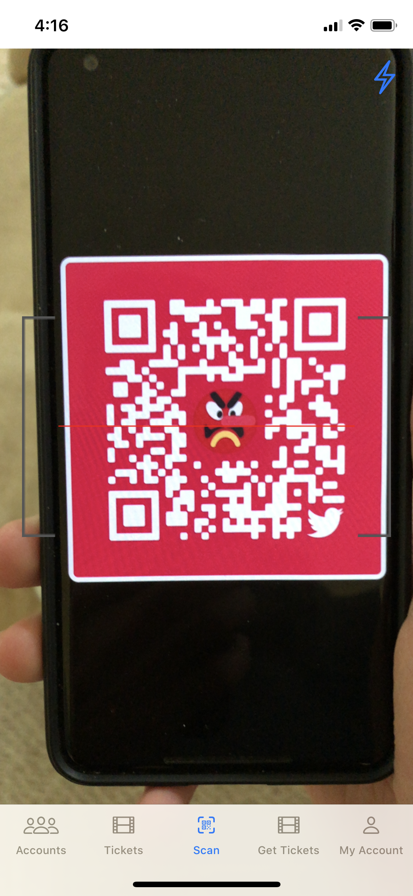
Scan tab displays camera view

Slide 43
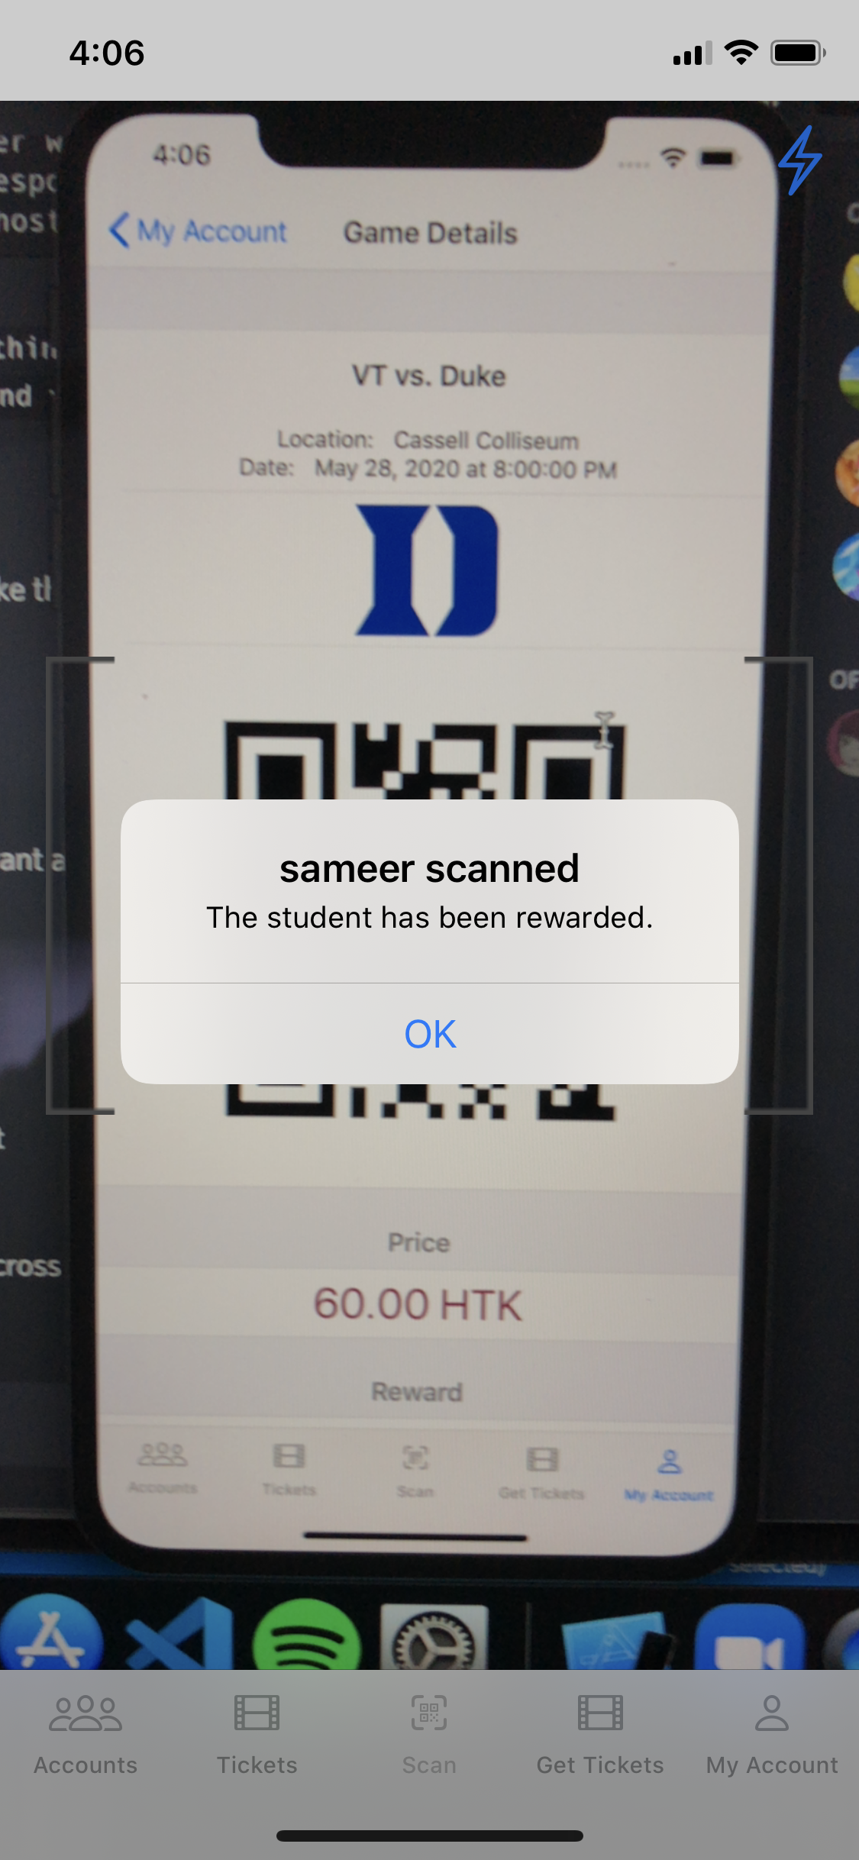
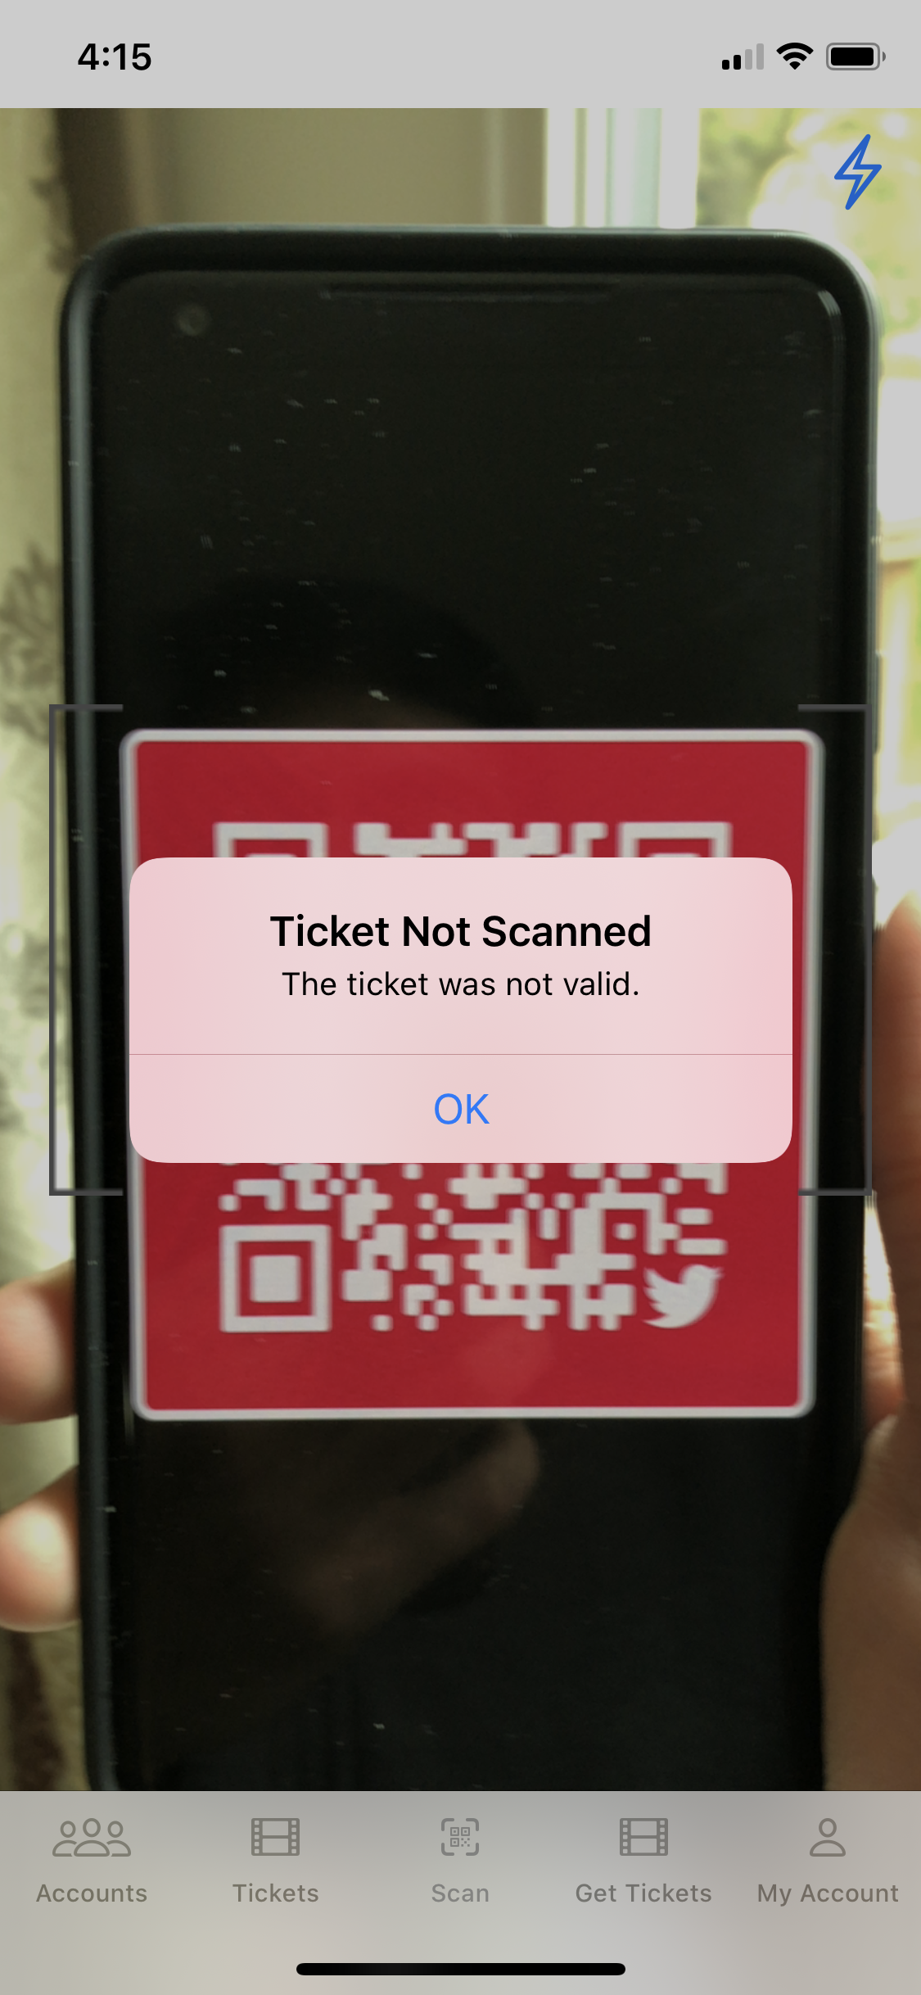
QR code is validated and rewards the user holding the ticket

